Slide 1
Probability and Statistics Review
Thursday Sep 11

Slide 2
The Big Picture
Probability
Model
Data
Estimation/learning
But how to specify a model?

Slide 3
Graphical Models
How to specify the model?
  What are the variables of interest?
  What are their ranges?
  How likely their combinations are?
You need to specify a joint probability distribution
  But in a compact way
    Exploit local structure in the domain
Today: we will cover some concepts that formalize the above statements

Slide 4
Probability Review
Events and Event spaces
Random variables
Joint probability distributions
  Marginalization, conditioning, chain rule, Bayes Rule, law of total probability, etc.
Structural properties
  Independence, conditional independence
Examples
Moments

Slide 5
Sample space and Events
Ω : Sample Space, result of an experiment
  If you toss a coin twice Ω = {ΗΗ,ΗΤ,ΤΗ,ΤΤ}
Event: a subset of Ω
  First toss is head = {HH,HT}
S: event space, a set of events:
  Closed under finite union and complements
    Entails other binary operation: union, diff, etc.
  Contains the empty event and Ω

Slide 6
Probability Measure
Defined over (Ω,S) s.t.
  P(α) >= 0 for all α in S
  P(Ω) = 1
  If α, β are disjoint, then
    P(α U β) = p(α) + p(β)
We can deduce other axioms from the above ones
      Ex: P(α U β) for non-disjoint event

Slide 7
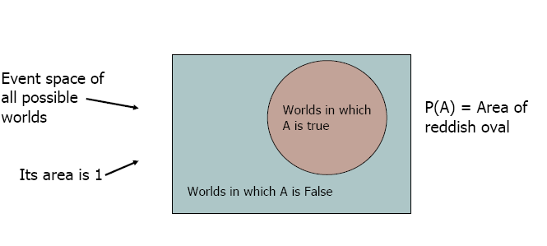
Visualization
We can go on and define conditional probability, using the above visualization

Slide 8
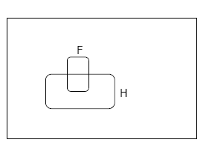
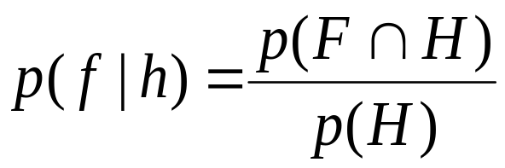
Conditional Probability
P(F|H) = Fraction of worlds in which H is true that also have F true

Slide 9
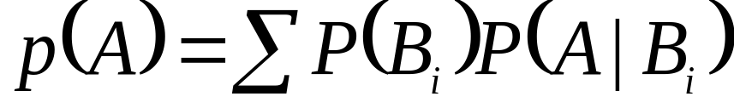
Rule of total probability
B₅
B₃
B₂
B₄
A
B₁
B₇
B₆

Slide 10
From Events to Random Variable
Almost all the semester we will be dealing with RV
Concise way of specifying attributes of outcomes
Modeling students (Grade and Intelligence):
  Ω = all possible students
  What are events
    Grade_A = all students with grade A
    Grade_B = all students with grade A
    Intelligence_High = … with high intelligence
  Very cumbersome
  We need “functions” that maps from Ω to an attribute space.

Slide 11

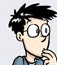
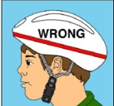

Random Variables
Ω
I:Intelligence
High
low
A
G:Grade
B
A+

Slide 12
Random Variables
Ω
I:Intelligence
High
low
A
G:Grade
B
A+
P(I = high) = P( {all students whose intelligence is high})

Slide 13
Probability Review
Events and Event spaces
Random variables
Joint probability distributions
  Marginalization, conditioning, chain rule, Bayes Rule, law of total probability, etc.
Structural properties
  Independence, conditional independence
Examples
Moments

Slide 14
Joint Probability Distribution
Random variables encodes attributes
Not all possible combination of attributes are equally likely
  Joint probability distributions quantify this
P( X= x, Y= y) = P(x, y)
  How probable is it to observe these two attributes together?
  Generalizes to N-RVs
  How can we manipulate Joint probability distributions?

Slide 15
Chain Rule
Always true
  P(x,y,z) = p(x) p(y|x) p(z|x, y)
      = p(z) p(y|z) p(x|y, z)
      =…

Slide 16
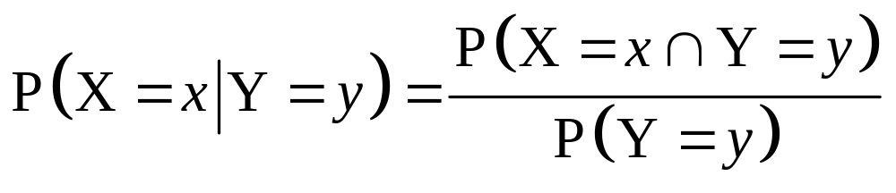
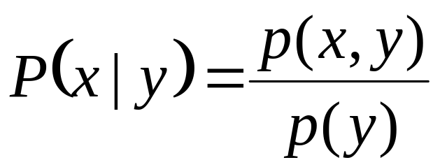
Conditional Probability
events
But we will always write it this way:

Slide 17
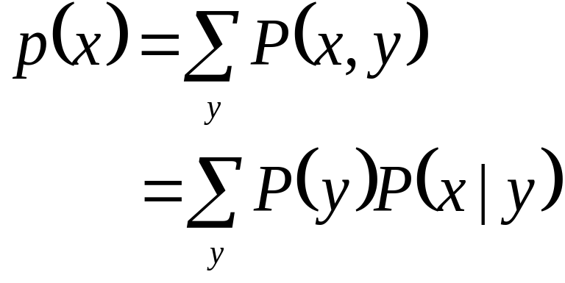
Marginalization
We know p(X,Y), what is P(X=x)?
We can use the low of total probability, why?
B₅
B₃
B₂
B₄
A
B₇
B₆
B₁

Slide 18
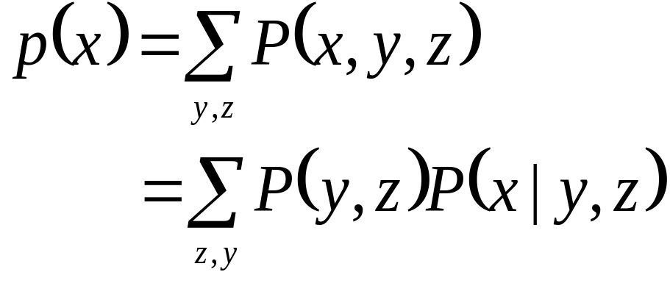
Marginalization Cont.
Another example

Slide 19
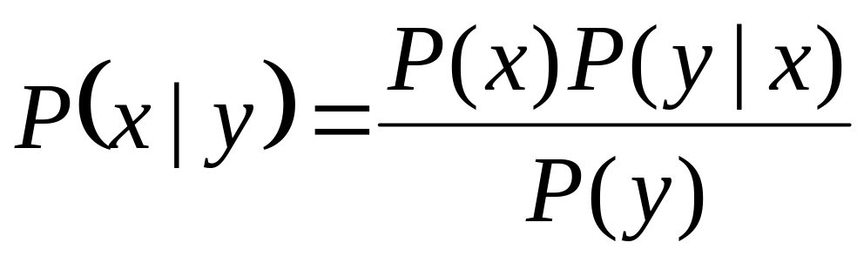
Bayes Rule
We know that P(smart) = .7
  If we also know that the students grade is A+, then how this affects our belief about his intelligence?
  Where this comes from?

Slide 20
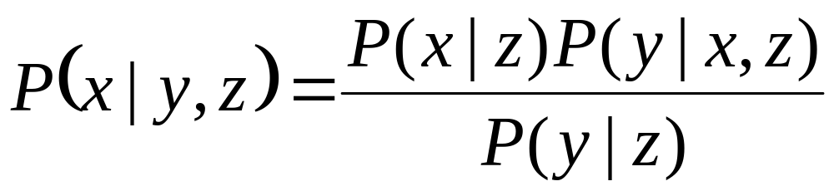
Bayes Rule cont.
You can condition on more variables

Slide 21
Probability Review
Events and Event spaces
Random variables
Joint probability distributions
  Marginalization, conditioning, chain rule, Bayes Rule, law of total probability, etc.
Structural properties
  Independence, conditional independence
Examples
Moments

Slide 22
Independence
X is independent of Y means that knowing Y does not change our belief about X.
  P(X|Y=y) = P(X)
  P(X=x, Y=y) = P(X=x) P(Y=y)
    Why this is true?
  The above should hold for all x, y
  It is symmetric and written as X ⊥ Y

Slide 23
CI: Conditional Independence
RV are rarely independent but we can still leverage local structural properties like CI.
X ⊥ Y | Z if once Z is observed, knowing the value of Y does not change our belief about X
  The following should hold for all x,y,z
  P(X=x | Z=z, Y=y) = P(X=x | Z=z)
  P(Y=y | Z=z, X=x) = P(Y=y | Z=z)
  P(X=x, Y=y | Z=z) = P(X=x| Z=z) P(Y=y| Z=z)
We call these factors : very useful concept !!

Slide 24
Properties of CI
Symmetry:
  (X ⊥ Y | Z) ⇒ (Y ⊥ X | Z)
Decomposition:
  (X ⊥ Y,W | Z) ⇒ (X ⊥ Y | Z)
Weak union:
  (X ⊥ Y,W | Z) ⇒ (X ⊥ Y | Z,W)
Contraction:
  (X ⊥ W | Y,Z) & (X ⊥ Y | Z) ⇒ (X ⊥ Y,W | Z)
Intersection:
  (X ⊥ Y | W,Z) & (X ⊥ W | Y,Z) ⇒ (X ⊥ Y,W | Z)
  Only for positive distributions!
  P(α)>0, 8α, α≠;
You will have more fun in your HW1 !!

Slide 25
Probability Review
Events and Event spaces
Random variables
Joint probability distributions
  Marginalization, conditioning, chain rule, Bayes Rule, law of total probability, etc.
Structural properties
  Independence, conditional independence
Examples
Moments

Slide 26
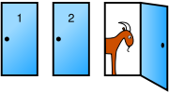
Monty Hall Problem
You're given the choice of three doors: Behind one door is a car; behind the others, goats.
You pick a door, say No. 1
The host, who knows what's behind the doors, opens another door, say No. 3, which has a goat.
Do you want to pick door No. 2 instead?

Slide 27

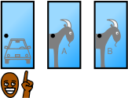

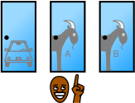
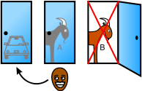
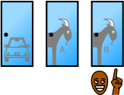
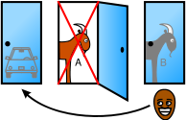
 |  | Host must reveal Goat B
 |  | Host must reveal Goat A
Host reveals Goat A or Host reveals Goat B

Slide 28

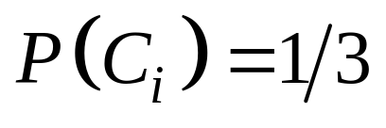
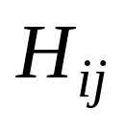
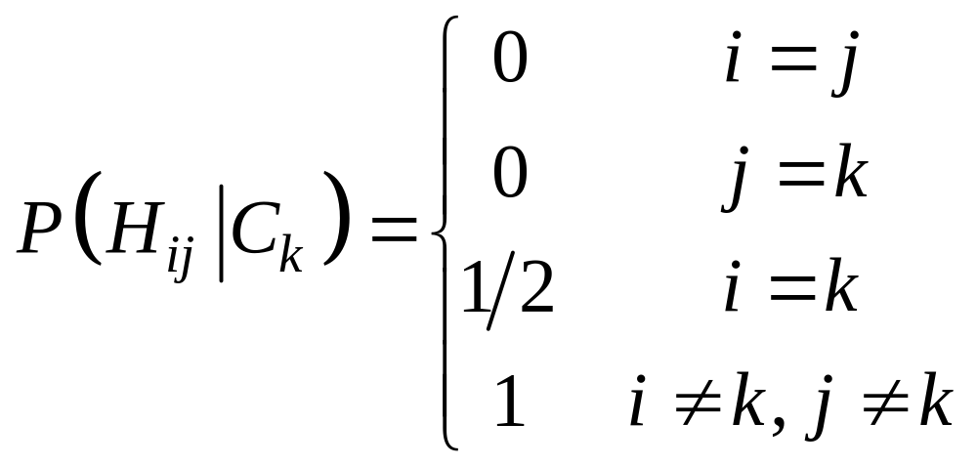
Monty Hall Problem: Bayes Rule
: the car is behind door i, i = 1, 2, 3
: the host opens door j after you pick door i

Slide 29
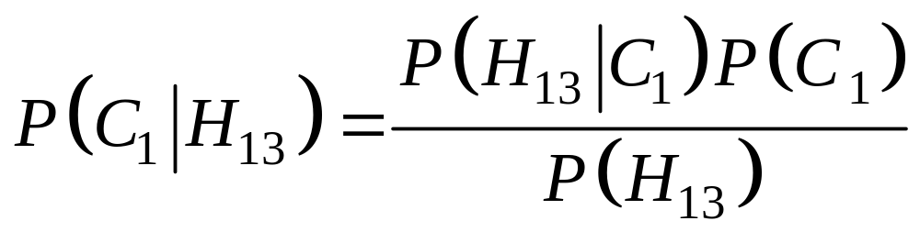
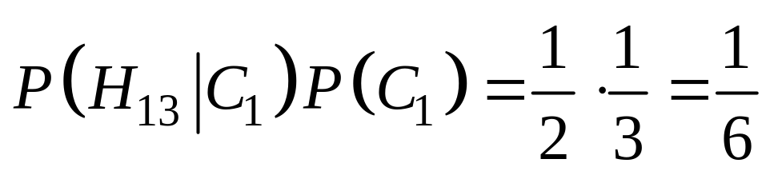
Monty Hall Problem: Bayes Rule cont.
WLOG, i=1, j=3

Slide 30
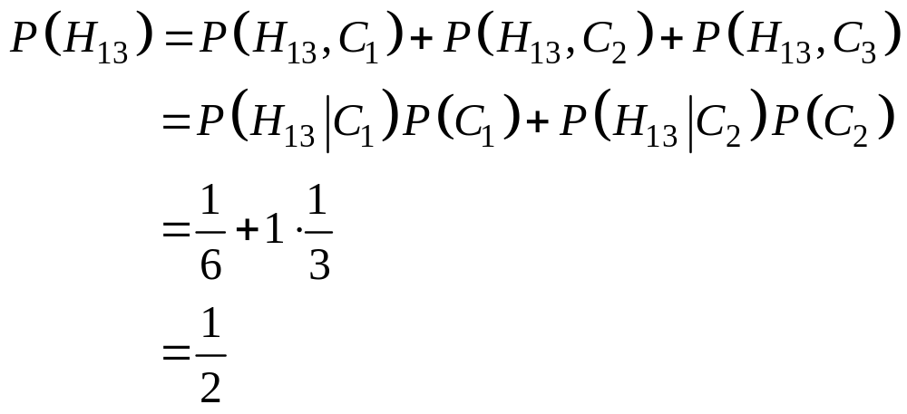
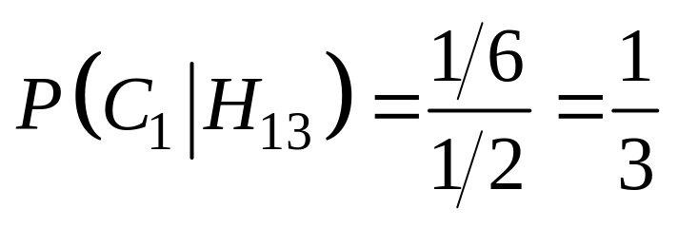
Monty Hall Problem: Bayes Rule cont.

Slide 31
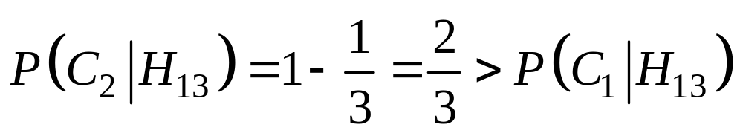
Monty Hall Problem: Bayes Rule cont.
You should switch!

Slide 32
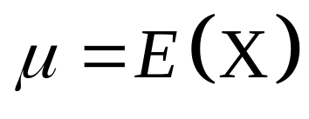
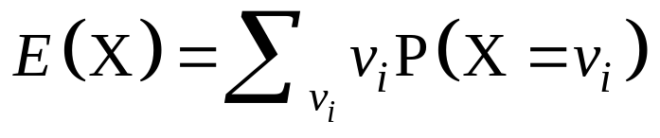
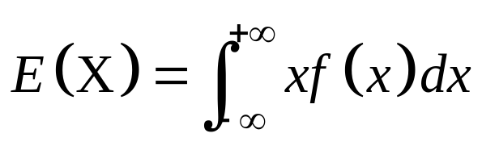
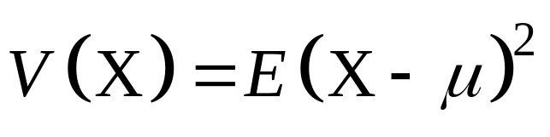
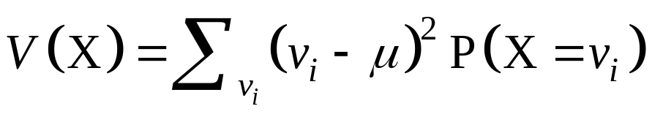
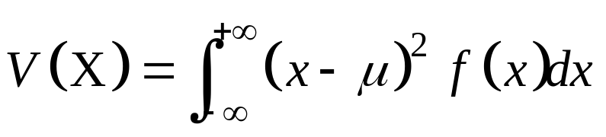
Moments
Mean (Expectation):
  Discrete RVs:
  Continuous RVs:
Variance:
  Discrete RVs:
  Continuous RVs:

Slide 33
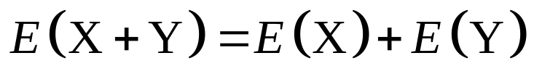
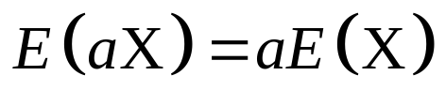
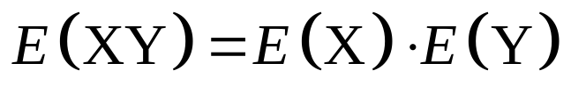
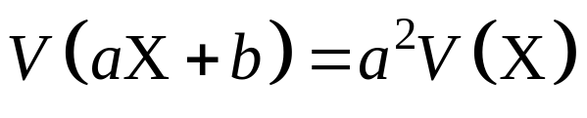
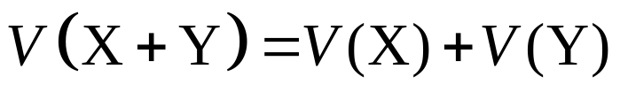
Properties of Moments
Mean
  If X and Y are independent,
Variance
  If X and Y are independent,

Slide 34
The Big Picture
Probability
Model
Data
Estimation/learning

Slide 35
Statistical Inference
Given observations from a model
  What (conditional) independence assumptions hold?
    Structure learning
  If you know the family of the model (ex, multinomial), What are the value of the parameters: MLE, Bayesian estimation.
    Parameter learning

Slide 36
MLE
Maximum Likelihood estimation
  Example on board
    Given N coin tosses, what is the coin bias (θ )?
Sufficient Statistics: SS
  Useful concept that we will make use later
  In solving the above estimation problem, we only cared about N_{h}, N_{t} , these are called the SS of this model.
    All coin tosses that have the same SS will result in the same value of θ
    Why this is useful?

Slide 37
Statistical Inference
Given observation from a model
  What (conditional) independence assumptions holds?
    Structure learning
  If you know the family of the model (ex, multinomial), What are the value of the parameters: MLE, Bayesian estimation.
    Parameter learning
We need some concepts from information theory

Slide 38
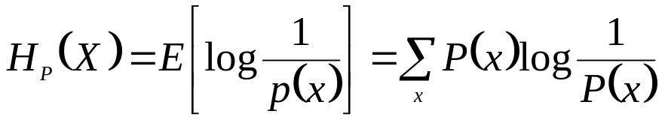
Information Theory
P(X) encodes our uncertainty about X
  Some variables are more uncertain that others
  How can we quantify this intuition?
    Entropy: average number of bits required to encode X
P(X)
P(Y)
X
Y

Slide 39
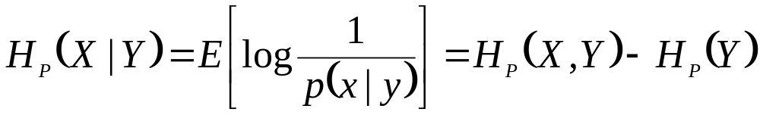
Information Theory cont.
Entropy: average number of bits required to encode X
We can define conditional entropy similarly
We can also define chain rule for entropies (not surprising)

Slide 40

Mutual Information: MI
Remember independence?
  If X⊥Y then knowing Y won’t change our belief about X
  Mutual information can help quantify this! (not the only way though)
MI:
  Symmetric
  I(X;Y) = 0 iff, X and Y are independent!

Slide 41
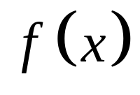
Continuous Random Variables
What if X is continuous?
Probability density function (pdf) instead of probability mass function (pmf)
A pdf is any function that describes the probability density in terms of the input variable x.

Slide 42
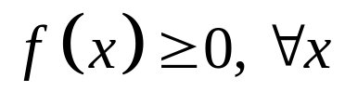
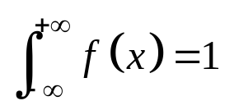
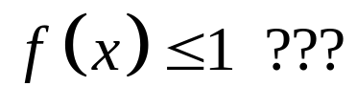
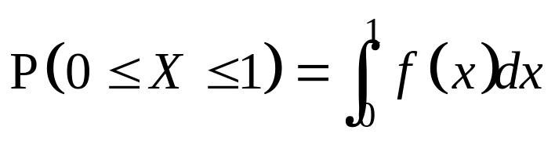
PDF
Properties of pdf
Actual probability can be obtained by taking the integral of pdf
  E.g. the probability of X being between 0 and 1 is

Slide 43
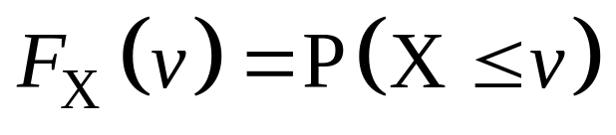
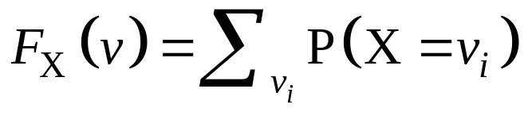
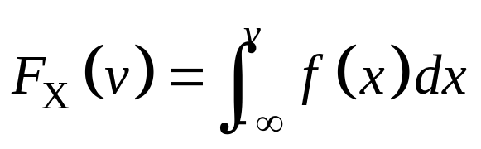
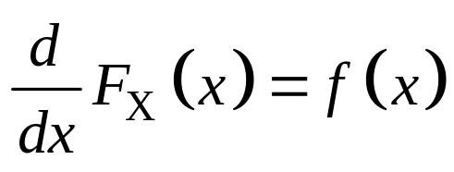
Cumulative Distribution Function
Discrete RVs
Continuous RVs

Slide 44
Acknowledgment
Andrew Moore Tutorial: http://www.autonlab.org/tutorials/prob.html
Monty hall problem: http://en.wikipedia.org/wiki/Monty_Hall_problem
http://www.cs.cmu.edu/~guestrin/Class/10701-F07/recitation_schedule.html

